Slide 1
Google Slide Link
https://docs.google.com/presentation/d/1-M2Io9h5FO6_0lBA5GrdOXqvhNlpyZPJU8GInCRWe3w/edit?usp=sharing

Slide 2
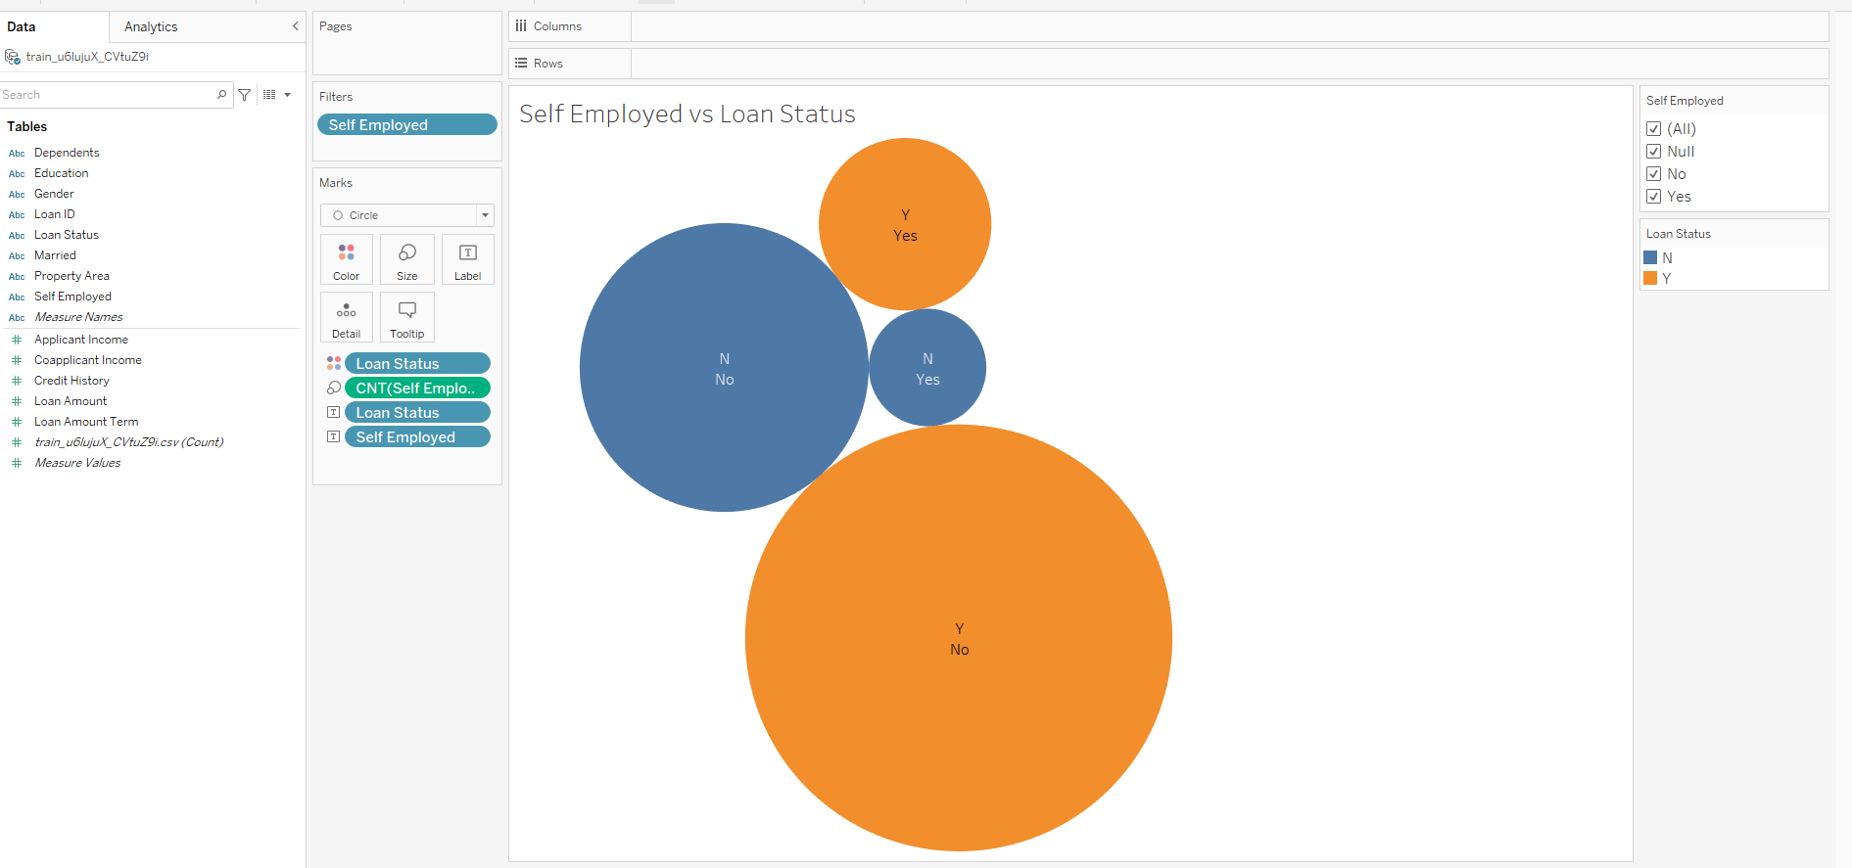
Blueprint of Dashboard
Individual Worksheets created in Tableau (sample of one of the worksheets seen below)

Slide 3
Blueprint of Dashboard
Individual Workbooks created in Tableau

Slide 4
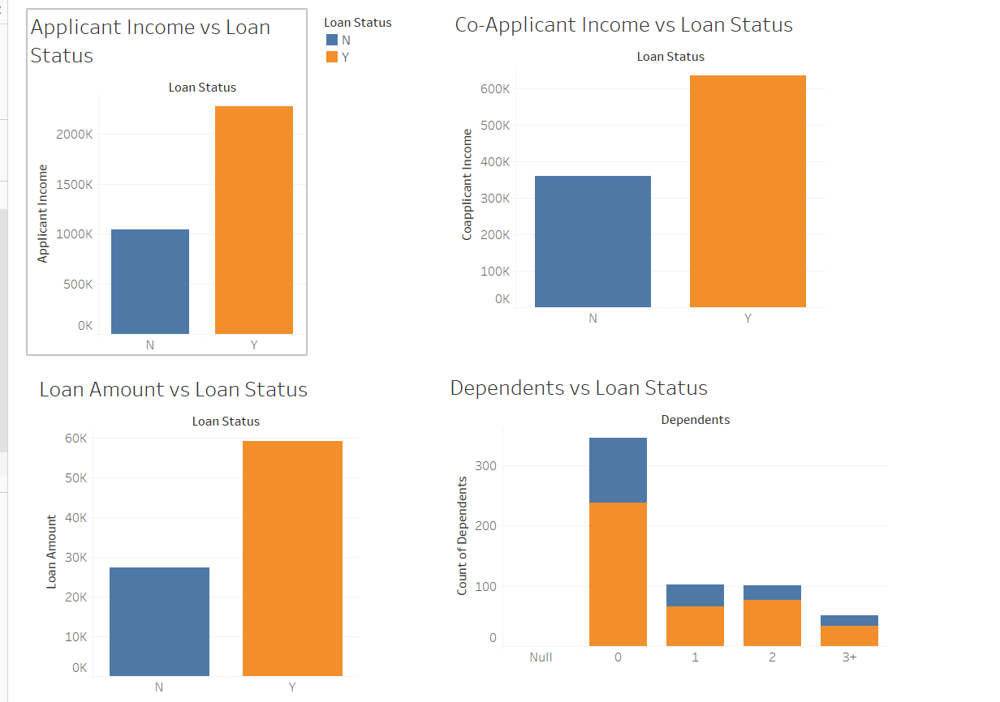
Blueprint of Dashboard
Three Dashboards created in Tableau (Sample as seen below)

Slide 5
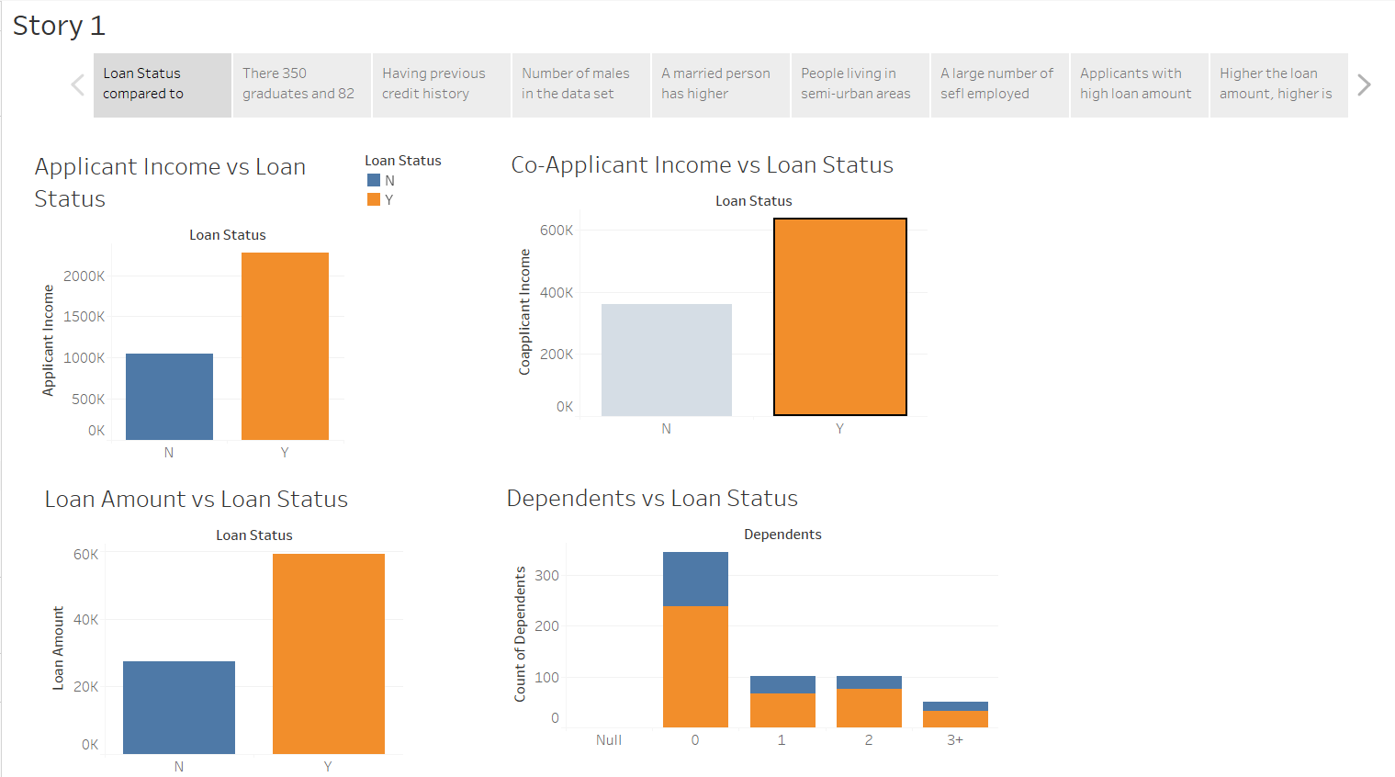
Blueprint of Dashboard
Final Story board with different analysis created in Tableau (Sample as seen below)

